Slide 1
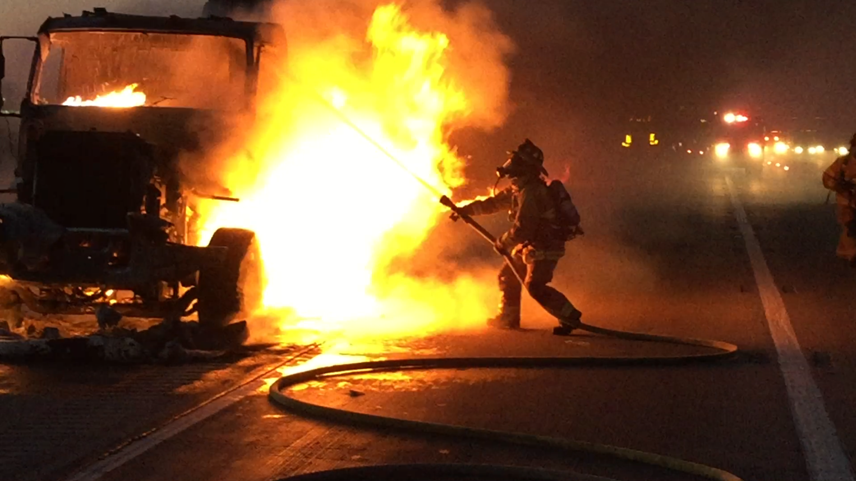
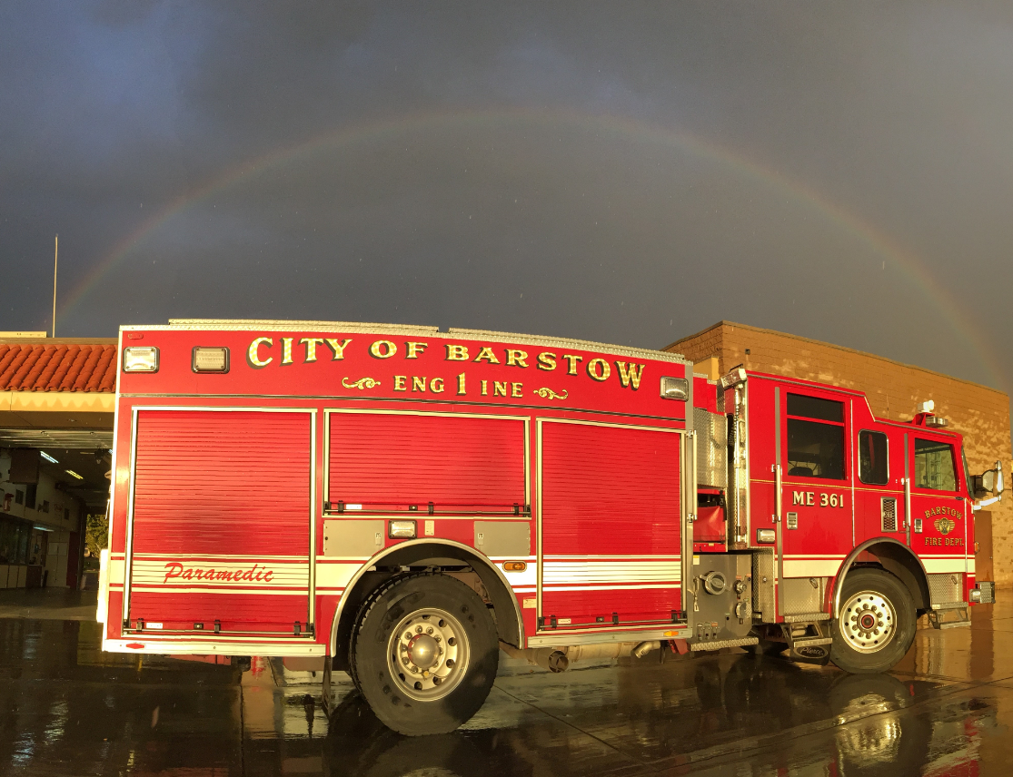
Barstow Fire Protection District
Strategic Operations Plan

Slide 2

Our Mission
Our mission is to protect lives and property of all people within our district by providing fire, emergency medical, and non-emergency services

Slide 3
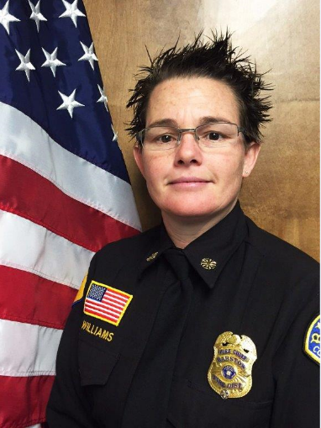
YOUR Fire Chief
Born and raised in Barstow
Grew up in the fire service here locally
Completion of Chief Officer State Training
Associates Degree in Fire Science
102 units toward Bachelors of Fire Service Administration
Notes:
I am proud to present the Barstow Fire Protection District’s strategic plan for 2019-2023. In order to provide comprehensive fire, rescue and emergency medical services to those who work, live and play in Barstow, the Barstow Fire Department must continuously respond to changes, solve problems, collaborate on issues, assess community needs and develop viable solutions. Like many fire departments in our region, we have seen a steady increase in calls for service which challenge our core program service delivery expectations. The strategic planning process allowed us to evaluate all aspects of how we provide service to the City of Barstow and the Fire District as a whole, compare that to industry standards and best practices, then develop a plan to ensure we do the very best we can with the resources we

Slide 4
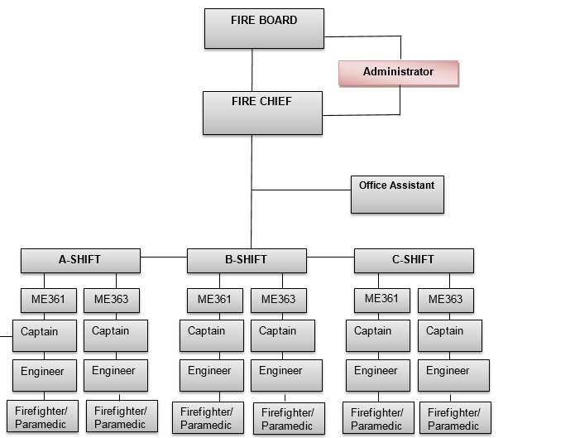
Your Fire Department
Notes:
Each Engine Company is made up of three personnel.
Captain commands an engine company and is responsible for the supervision Fire Engineers and Firefighter/Paramedics
Engineer responding to fire and emergency medical calls for service by driving fire vehicles, operates pumping engine; compute and regulate water pressure, maintains equipment and facilities
Firefighter/Paramedic lowest position on the org chart, they lay hose lines, and direct water stream, set up ladders, directly involved with performing rescue, ventilate buildings clean up and salvage work;
It is important to note here that the national standard for each engine company is four person per engine and this is directly a result of the number of tasks it takes to perform at a house or commercial fire. These 10 essential tasks require additional firefighters on scene than we currently have, and if there is a victim rescue situation that number jumps to 12 essential tasks required.

Slide 5
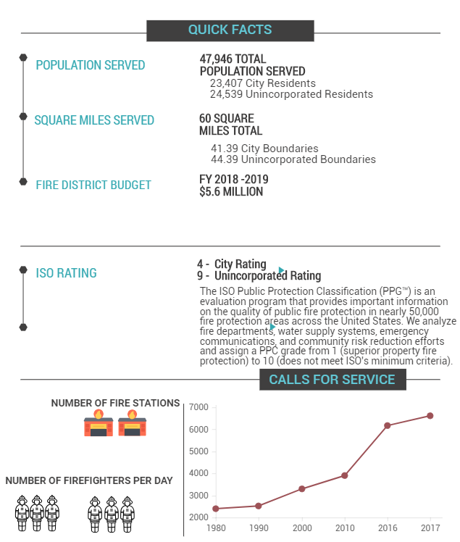
Demographics

Slide 6
Critical Issues and Service Gaps
Financial Sustainability | Internal Communications | Succession Planning
Department Infrastructure | External Communications | Training
Organizational Sustainability | Information Technology | Fire Prevention/Investigation
Community Outreach | Emergency Preparedness and Education
Notes:
After reviewing the Fire District core programs and support services, and identifying internal strengths and weaknesses along with external opportunities and threats, the following primary critical issues and service gaps were identified as the foundation for the development of goals and objectives in order to meet the future vision.

Slide 7
Strategic Goals
Goal 1 – Provide Exceptional All-Hazards Service Delivery, and Evaluate Organizational and Process Improvements
Goal 2 – Maintain Highly Skilled, Accountable and Resilient Workforce
Goal 3 – Focus on Resource Management
Goal 4 – Capitalize on Technology
Goal 5 – Promote Community Relations and Engagement
Notes:
5 Strategic Goals designed to address key issues identified during the strategic planning process and 35 Action Items that provide a method for achieving those goals.
Goal 1 – Provide Exceptional All-Hazards Service Delivery, and Evaluate
Organizational and Process Improvements
BFPD makes every effort to maintain and improve quality, value, efficiency and timeliness of services delivered while also planning for challenges including changes in population, demographics and budgetary constraints. This goal emphasizes BFPD’s commitment for continuous improvement through its management of priorities and objectives, and its evaluation of services, programs and projects.
Goal 2 – Maintain Highly Skilled, Accountable and Resilient Workforce
Firefighter safety, survivability and health are essential for BFPD. The ability to protect human lives are greatly impacted by the knowledge, skills and training of our personnel. A well-rounded and educated workforce is essential to BFPD’s ability to perform. This goal will ensure that personnel are prepared to take on leadership positions, have a variety of technical and non-technical training, promote teamwork and enhance morale.
Goal 3 – Focus on Resource Management
Well-maintained and up-to-date facilities, equipment and apparatus are important for BFPD to continue providing high quality emergency response, well-trained employees, and a safe and healthy environment. This goal reinforces the importance of optimal use of physical and financial resources.
Goal 4 – Capitalize on Technology
In general, BFPD’s technology infrastructure is satisfactory; however, continued upgrades are needed for key services, programs and projects. This goal will focus on regularly assessing technology improvements that will enhance service delivery and efficiencies.
Goal 5 – Promote Community Relations and Engagement
BFPD is committed to maintaining its high value and support within the community. This goal will address the desire for increased opportunities to engage with the community and raise public awareness of the district’s fire safety and prevention programs, services and special projects. Communication and engagement are essential to providing the best services to the residents of the Fire District.

Slide 8
Fire/EMS Staffing Plan
Year 1 (2019)
ADD 6 Firefighter/Paramedics
ADD Paramedic Squad
Increase Firefighter Training
Provide means to establish additional rapid paramedic services with in the fire district
Establish staffed paramedic squad to address the rise in medical calls. Reduce call load and workload of ME361 AND increase the availability time of ME361
Notes:
I would like to provide an overview and summary of the immediate action plan of strategies if Measure Q is approved by the voters this November. A more detailed plan will be found in the entire Strategic Operating Plan.
Year 1 Add 6 Firefighter Paramedics and purchase a new paramedic squad
Provide means to establish additional rapid paramedic services with in the fire district
Establish staffed paramedic squad to address the rise in medical calls. Reduce call load and workload of ME361 AND increase the availability time of ME361

Slide 9
Fire/EMS Staffing Plan
Year 2 (2020)
PURCHASE NEW TYPE I ENGINE TO REPLACE ME363
ADD 3 BATTALION CHIEFS
UPGRADE STATION 361
REPLACE SWAMP COOLERS AT STA 361 IN THE BAYS
Notes:
PURCHASE NEW TYPE I ENGINE TO REPLACE ME363; ME363 will have well over 200k miles on as front line apparatus. It will be 6 years past the projected end of life. Reduce maintenance cost, reduce down time due to wear and tear maintenance.
ADD 3 BATTALION CHIEFS; Improve command and control, responsible for directing team development, A Battalion Chief directs emergency scene operations on a 24 hour basis and supervises or performs specialized functions in support of Fire Department operations. Essential functions include the following: Commands all fire fighting, lifesaving and fire prevention operations in an assigned district; sets up command post at fire or accident scenes; may set up or assume multiple command posts at a single incident; Supervises administrative details; monitors leaves; administers discipline. Makes daily staffing assessment for all stations in district; rotates personnel as needed; Completes all necessary reports, correspondence, and documentation as required in the performance of assigned duties.
UPGRADE STATION 361; Establish housing for additional needed staffing projected for years 3 and 4
REPLACE SWAMP COOLERS AT STA 361 IN THE BAYS ;Currently only 1 out of the three evaporative coolers work
Energy efficient, reduce energy cost, proper temperature for medication storage

Slide 10
Fire/EMS Staffing Plan
Year 3 (2021)
PURCHASE 1 NEW LADDER TRUCK COMPANY
ADD 3 FIRE CAPTAINS
ADD 3 FIRE ENGINEERS
ADD 3 FIREFIGHTER/PARAMEDICS
REPLACE HEATERS IN BAY AT STATION 361
Notes:
PURCHASE NEW LADDER TRUCK COMPANY
Improves operational capacity to address Community Fire Risk; A ladder truck company or aerial ladder is a power operated ladder that allows firefighters to easily climb and descend between the tip and the ladder and the turntable for either fire fighting or rescue operations.
Main uses of aerial ladders are recue, ventilation, elevated master stream application, and gaining access to upper levels of an emergency scene.
ADD 3 FIRE CAPTAINS
ADD 3 FIRE ENGINEERS
ADD 3 FIREFIGHTER/PARAMEDICS- Staff new Ladder Truck Company Create cross staffed concept, partial staffing of Truck Company – cross staffing by squad Re-establish critical Truck Company response
REPLACE HEATERS IN BAYS AT STATION 361 and 363- Currently only 1 heater works at station 361, 20 plus years old. Energy efficiency, reduce energy cost, proper temperature for medication storage.

Slide 11
Fire/EMS Staffing Plan
Year 4 (2022)
CONDUCT FEASABILITY STUDY TO BUILD STATION 362 NORTH SIDE OF TOWN
Notes:
CONDUCT FEASABILITY STUDY TO BUILD STATION 362 NORTH SIDE OF TOWN
Meet standards of coverage needs for the north side of the Fire District.

Slide 12
Fire/EMS Staffing Plan
Year 5-6 (2023-2024)
BUILD STATION ON NORTH SIDE (PENDING REVIEW OF FEASABILITSTUDY):
PURCHASE 1 NEW TYPE III BRUSH ENGINE
ADD 3 CAPTAINS
ADD 3 ENGINEERS
ADD 3 FIREFIGHTER/PARAMEDICS
Notes:
BUILD STATION ON NORTH SIDE (PENDING REVIEW OF FEASABILITSTUDY) Reduce response times to areas north or the river in the areas of Irwin estates, Skyline North and Soapmine areas. Addresses access routes to the North side of the Fire District during construction and natural or man-made disasters.
ADD 3 CAPTAINS 3 ENGINEERS 3 FIREFIGHTER/PARAMEDICS
Staff Type III Brush engine, open station 362. Improves operational capacity to address Community Fire Risk in our most high risk wildland interface portions of the fire district.

Slide 13
Fire/EMS Staffing Plan
Year 6 and beyond (2024-)
Evaluate progress of BFPD Strategic Plan 2019-2023 and update
Re-assess and re-deploy Fire/EMS resources based on Data and Community Risk Analysis Develop plan, Performance based monitoring to address future service related impacts and resource needs
Notes:
Year 6 and beyond (2024-)
Evaluate progress of BFPD Strategic Plan 2019-2023 and update ;Maintain safety improvements of previous four years. Increase fire prevention and suppression
activities throughout the city.
Re-assess and re-deploy Fire/EMS resources based on Data and Community Risk Analysis Develop Continuous Quality Improvement plan and Performance based monitoring to address future service related impacts and resource needs

Slide 14
Total Build Out Through Year 2023
Department
  Current Staffing = 18
  Proposed Staffing = 36
Resources
  Current = 2 Fire Engines
  Proposed = 2 Fire Engines
  1 Paramedic Squad
  1 Staffed Ladder Truck
  1 Staffed Type II Wildland Brush Engine

Slide 15
Thank You.
Fire Chief Jamie Williams
760 256 2254
jwilliams2@barstowca.org
www.barstowca.org

